Slide 1

Chapter 2
Computational Thinking for Science (CT-S) Framework and Pedagogical Strategies
Computing Science for Science Teaching
วิทยาการคำนวณสำหรับการสอนวิทยาศาสตร์
CHEWA THASSANA
Center for AI Powered Digital AgriPhysics Research

Slide 2

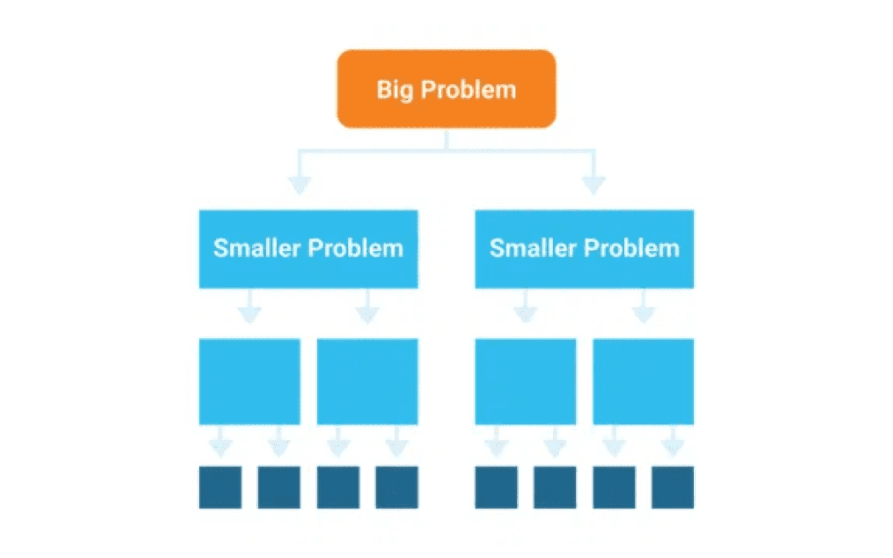
Decomposition: Breaking Down Complex Scientific Problems
Definition: Decomposition is the process of breaking down a complex scientific problem or system into smaller, more manageable components or sub-problems.
Why It Matters
Complex systems in science (ecosystems, chemical reactions, astronomical
phenomena) are difficult to understand as a whole. By decomposing them, we
can study individual components and their interactions.
Example: Photosynthesis
Scientists decompose photosynthesis into: light absorption, electron transfer, ATP
synthesis, and carbon fixation. Each component can be studied separately before
understanding how they work together.
Classroom Application
Students learn to identify the key components of a scientific system and
understand how they interact to produce the observed phenomenon.

Slide 3

Abstraction: Focusing on Essential Details While Filtering Out Noise
Definition: Abstraction is the cognitive process of identifying and focusing on the essential information and patterns while deliberately ignoring irrelevant details.
Purpose: Abstraction allows scientists to create simplified models of complex systems. Without abstraction, the complexity becomes unmanageable, and we cannot build computational models or simulations.
Example 1
Example 2
The Atomic Model
Population Models
We represent atoms as spheres with electrons orbiting a nucleus, even though the actual quantum mechanical reality is far more complex. This simplification allows us to understand chemical bonding and reactions.
In ecology, we abstract a forest ecosystem to a simple population model with just a few key variables (birth rate, death rate, carrying capacity) rather than tracking every individual organism.
Abstraction enables scientists to build computational models and simulations that are both tractable and meaningful, allowing us to understand and predict complex phenomena.

Slide 4

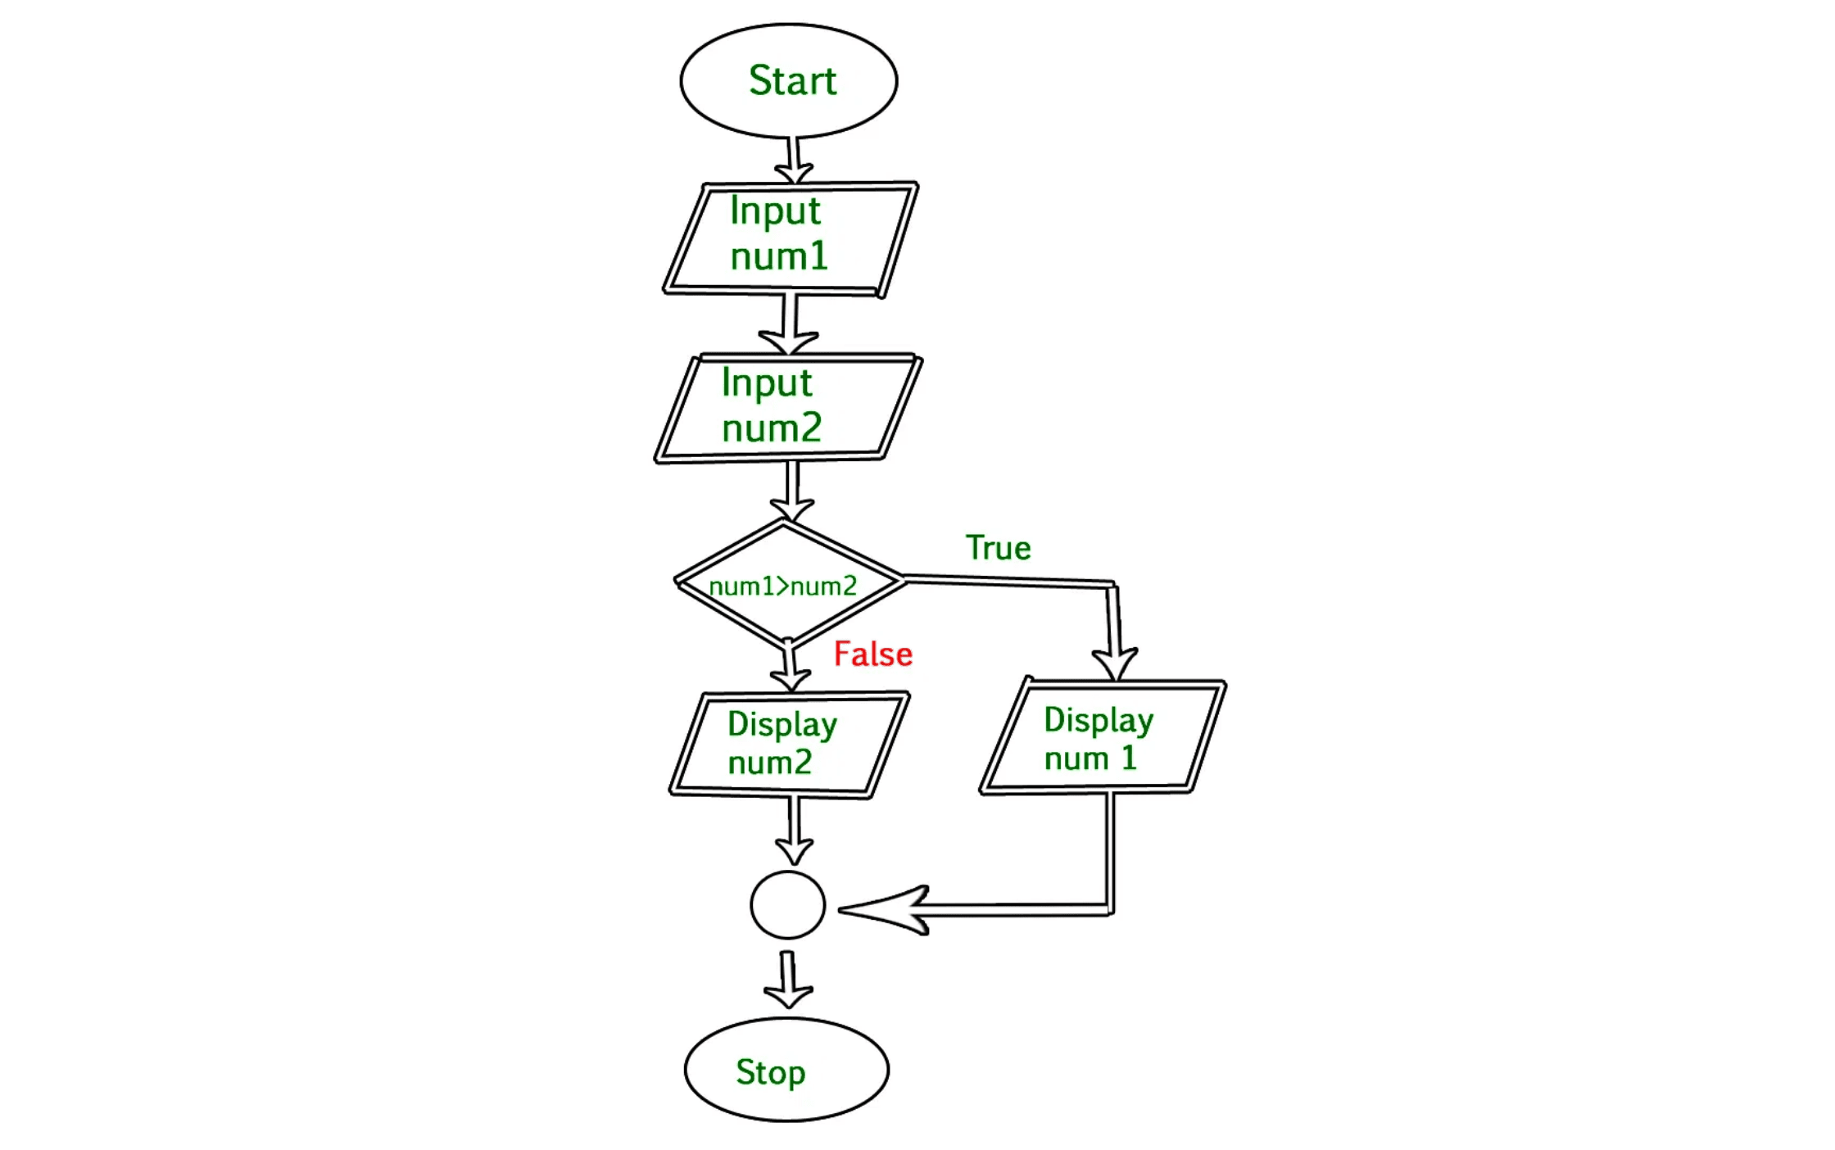
Algorithms: Step-by-Step Procedures for Scientific Problem-Solving
Definition: An algorithm is a finite sequence of well-defined instructions or rules designed to solve a specific problem or accomplish a particular task.
Characteristics
Good algorithms are clear, precise, finite, and reproducible. These same
characteristics are valued in scientific methodology, making algorithms a natural
fit for science education.
Scientific Applications
Data processing: sorting data, calculating statistics
•
Simulation: modeling disease spread, weather patterns
•
Analysis: processing genetic sequences, astronomical data
•
Automation: controlling experiments, managing instruments
•
Connection to Science
The scientific method itself is an algorithm—a step-by-step procedure for
investigating phenomena and testing hypotheses.

Slide 5

The Computational Thinking for Science (CT-S) Framework: A Structured Approach
Framework Purpose
The CT-S framework provides a structured approach to integrating computational thinking into K-12 science education in a meaningful and authentic way.
Theoretical Foundation
Rooted in Activity Theory
Activity Theory emphasizes that human cognition and learning are mediated by tools and occur within goal-directed activities. In the
context of CT-S, the computational tool mediates the learner's interaction with scientific concepts and objectives.
Key Insight: CT-S is not just about using computers as tools, but about the cognitive processes involved when learners engage with computational tools to achieve scientific goals.
Framework Structure
A 4×3 Matrix Approach
The CT-S framework is conceptualized as a 4×3 matrix, illustrating the intersection of four categories of science activities with three types of
interactions with computational tools.
Four Science Activities: Data collection, data processing, modeling, and problem-solving
Three Types of Interactions: Reflective use, design of tools, and evaluation of tools
Outcome and Application
This matrix helps educators and researchers identify and design learning experiences that foster authentic CT-S development, ensuring that computational thinking is integrated meaningfully into science inquiry.

Slide 6

The Four Categories of Science Activities in CT-S
Activity 1
Activity 2
Activity 3
Activity 4
Data Collection
Data Processing
Modeling
Problem-Solving
Understanding how sensors and instruments work. Designing digital data collection systems. Evaluating the accuracy and limitations of data collection tools.
Cleaning and organizing raw data. Applying computational algorithms to transform data. Visualizing and interpreting processed data.
Creating computational representations of scientific systems. Running simulations to test hypotheses. Refining models based on experimental results.
Using computational approaches to solve authentic scientific problems. Integrating multiple CT practices to address complex challenges.
Integration: These activities are not isolated; they often overlap and build upon each other in authentic scientific inquiry, creating a holistic approach to science education.

Slide 7
How Students Interact with Computational Tools in Science
Interaction Type 1
Interaction Type 2
Interaction Type 3
Reflective Use
Design of Tools
Evaluation of Tools
Students use existing computational tools to accomplish scientific goals while thinking critically about the tool's capabilities, limitations, and assumptions.
Students create or customize computational tools to solve specific scientific problems. This involves programming, algorithm design, and tool development.
Students assess the accuracy, efficiency, and appropriateness of computational tools, considering how tool design choices influence scientific interpretation.
Example: Using a spreadsheet to analyze experimental data while evaluating the statistical methods it employs.
Example: Writing a Python script to process satellite imagery or designing a simulation model.
Example: Evaluating whether a data visualization accurately represents the underlying data or might be misleading.
Engaging in all three types of interactions promotes critical thinking and responsible use of technology in science education.

Slide 8

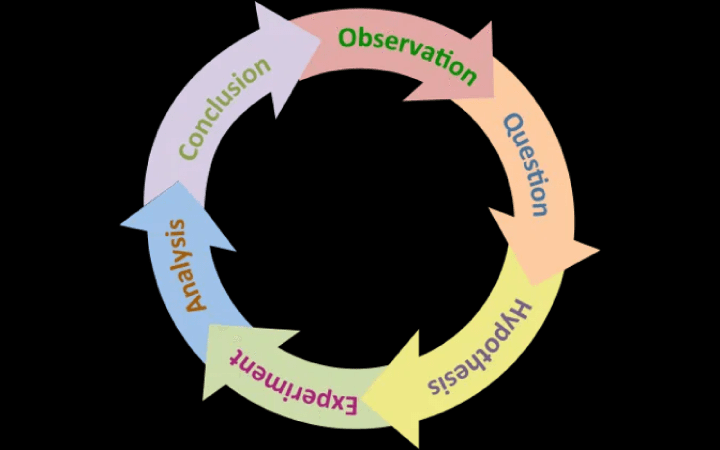
Inquiry-Based Learning: The Natural Home for CT-S
Alignment
Inquiry-based learning (IBL) naturally aligns with CT-S because both emphasize
problem-solving, investigation, and knowledge construction. They are
complementary pedagogical approaches.
Simultaneous Practice
When students design an experiment (decomposition), analyze data (pattern
recognition/abstraction), and draw conclusions (algorithmic thinking), they are
practicing IBL and CT-S simultaneously.
Computational Modeling Activities (CMAs)
Students build, refine, and test computational models of scientific phenomena. This process requires decomposing systems, recognizing patterns, abstracting essential features, and designing algorithms. Students engage in authentic scientific inquiry while developing computational thinking skills.
Classroom Implementation
Teachers design learning experiences where computational tools are integral to
the scientific inquiry process, not add-ons.
Key Benefit
Students see computational thinking as a natural and essential part of doing
science, not as a separate subject.

Slide 9


Effective Teaching Strategies for Integrating CT-S into Science
Strategy 1
Problem-Based Learning
Present students with authentic, complex scientific problems. Students use computational thinking and tools to investigate and solve these problems.
Example: "How can we predict the spread of a disease in a population?" Students build computational models to explore this question.
Strategy 2
Project-Based Learning
Students work on extended projects that require integrating multiple CT practices. Projects culminate in presentations or publications of findings.
Example: A semester-long project to monitor and analyze environmental data using computational tools.
Strategy 3
Scaffolded Instruction
Start with simpler computational tasks and gradually increase complexity. Provide templates and examples initially, then reduce support as students gain proficiency.
Example: Begin with pre-built models, then progress to modifying models, then designing models from scratch.
Strategy 4
Collaborative Learning
Students work in teams to tackle complex problems. Collaboration mirrors authentic scientific practice and leverages diverse skills.
Example: Some students focus on data collection, others on analysis, others on visualization and communication.

Slide 10

Challenges and Solutions for Integrating CT-S in Science Education
Barrier 1
Barrier 2
Teacher Preparation and Confidence
Limited Access to Technology
Challenge
Challenge
Many science teachers lack training in computational thinking and programming, making them
Schools may lack sufficient computers, software licenses, or reliable internet connectivity for
uncertain about how to teach these concepts.
computational activities.
Solution
Solution
Professional development programs, online resources, and collaborative learning communities
Use open-source tools, cloud-based platforms, and unplugged activities that teach CT concepts
can build teacher capacity and confidence.
without requiring computers.
Barrier 3
Barrier 4
Curriculum Crowding
Assessment Challenges
Challenge
Challenge
Science curricula are already full; finding time for CT seems impossible without removing
Traditional assessments don't capture CT skills; teachers need new ways to evaluate
essential content.
computational thinking alongside scientific understanding.
Solution
Solution
Recognize that CT enhances science learning. Integrate CT into existing units rather than
Develop performance-based assessments, portfolios, and rubrics that evaluate computational
treating it as a separate subject.
thinking and scientific reasoning together.
With strategic planning and support, CT-S can be integrated into science education in ways that enhance rather than burden teachers and students.

Slide 11

CT-S in Action: Examples from Science Education and Practice
Case Study 1
Case Study 2
Case Study 3
Climate Science Modeling
Genomics Data Analysis
Environmental Monitoring
Students use computational models to explore climate change scenarios. They decompose the climate system, abstract key variables (temperature, CO₂ levels, solar radiation), and run simulations to understand climate dynamics.
Students analyze genetic sequences using computational tools. They learn algorithms for sequence alignment and pattern recognition, understanding how modern genomics relies on computational approaches.
Students collect data using sensors, process it computationally, and visualize findings. They engage in all four science activities and all three types of tool interactions in an integrated project.
Outcome
Outcome
Outcome
Understanding of modern genomics and the computational
Authentic scientific inquiry with real-world relevance and
Deep understanding of climate dynamics and the role of
foundations of genetic research and biotechnology.
understanding of environmental data science.
computation in climate science research.
These examples demonstrate that CT-S can be implemented across diverse scientific domains and grade levels, providing transferable lessons for educators seeking to integrate computational thinking into their science curriculum.

Slide 12

Toward Computationally Fluent Science Educators and Students
Chapter 2 Key Takeaways
Takeaway 1
Takeaway 2
Structured Framework
Practical Tools
The CT-S framework provides a research-based, structured approach to integrating computational thinking into science education in a meaningful and authentic way.
Decomposition, abstraction, and algorithms are not abstract concepts but practical tools for scientific inquiry that students can apply immediately.
Takeaway 3
Takeaway 4
Natural Alignment
Overcoming Barriers
Inquiry-based learning naturally aligns with CT-S, creating opportunities for authentic integration without requiring separate curriculum time.
Effective pedagogical strategies and support systems can overcome implementation barriers, making CT-S accessible to all educators and students.

Slide 13

The Path Forward: Three Action Items for Educators
Action 1
Action 2
Action 3
Explore the CT-S framework and identify where it aligns with your current science curriculum.
Design one computational modeling activity for your students to experience CT-S in action.
Connect with colleagues and professional communities to share experiences and resources.
Next Chapter Preview
Chapter 3: Logical Reasoning and Programming Fundamentals
In the next chapter, we will explore the foundations of logical reasoning and programming. You will learn how to teach students to think algorithmically, write pseudocode and simple programs, and apply logical reasoning to solve computational problems. These skills form the technical foundation for implementing CT-S in your classroom.
Begin implementing CT-S in your science classroom. Start with one unit, one lesson, or one activity. The journey toward computational fluency starts with a single step.
CHEWA THASSANA
Center for AI Powered Digital AgriPhysics Research
Thank You

